Slide 1
Data Analytics
Fundamental Algorithms
Its tools & platform
Applications & Practice
Notes:
Maintenance

Slide 2
Probability
Statistic
Optimization
Machine learning
Data mining
Artificial intelligence
Pattern recognition
…
Scalability
Dimensionality
Complex and Heterogeneous Data
Data Quality
Data Ownership and Distribution
Privacy Preservation
Streaming Data
…

Slide 3
Data Analytics
Fundamental Algorithms

Slide 4
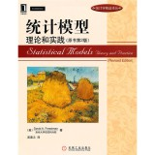




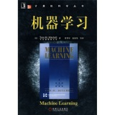


Slide 5
Outlines
Classification
Clustering
Association analysis
Page Rank
Collaborative filtering
Deep learning

Slide 6
Classification
KNN
Decision tree
Bayes Classification
Support vector machine (SVM)
Logistic regression(LR)
Boosting (AdaBoost)
Artificial Neural Networks (ANN)

Slide 7
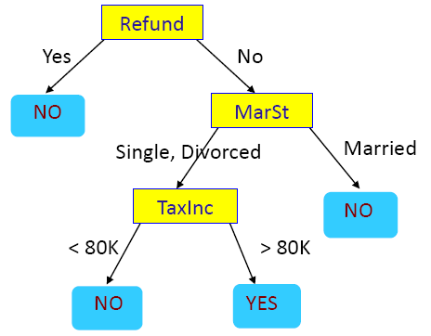
Decision tree
Feature selected to split:
Good split if we are more certain about classification after split,
Uniform distribution is bad.
Entropy/Gini
Pick feature which yields maximum information gain.
Max information gain = Min conditional entropy.
Notes:
Maintenance

Slide 8






Slide 9
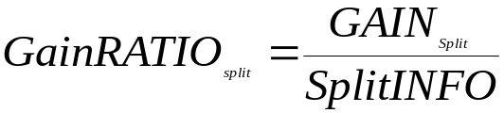
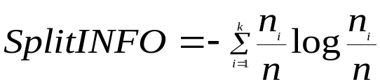
Algorithms
ID3
C4.5,
  use the gain ratio instead of pure information gain
  Consider the split information, small split is better.
CART
Decision tree can be used for classification, regression, predict and density estimation.
Decision tree will overfit.
  Pre-pruning: fixed depth/fixed number of leaves
  Post-pruning: Chi-square test of independence
  Complexity penalized/MDL model selection
Simple is best!!

Slide 10
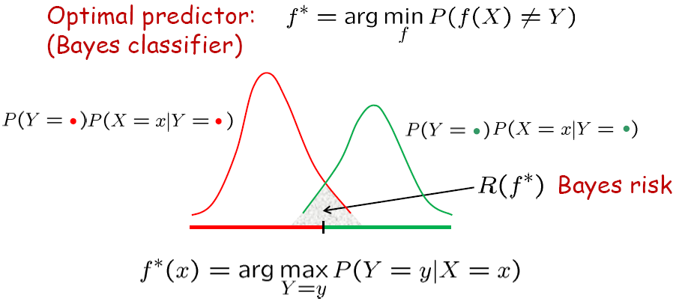

Bayes: Optimal predictor / Bayes classifier

Slide 11
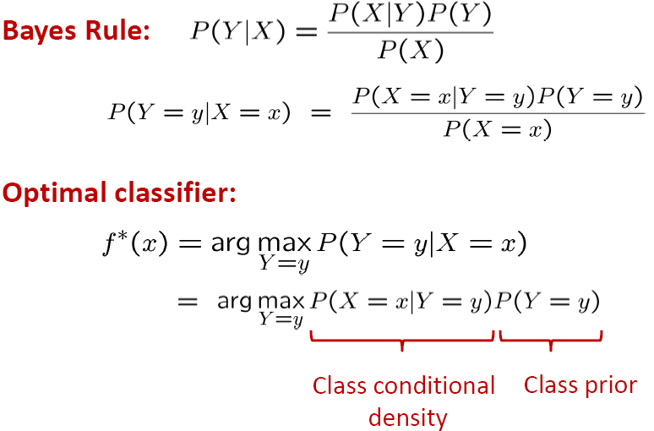
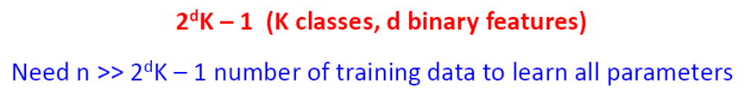
Posterior probability ➔ Prior probability

Slide 12
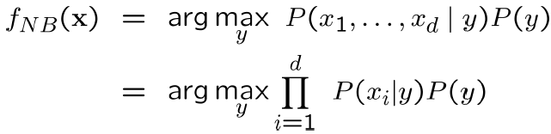
IF conditional independent ➔ Naïve Bayes Classifier
IF conditional independence assumption holds, naïve Bayes classifier is optimal! Bur worse otherwise…
Often perform well even this assumption is violated.

Slide 13
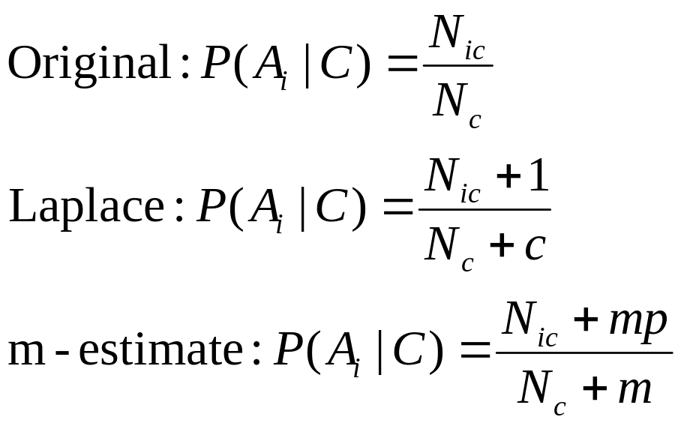
If one of the conditional probability is zero, then the entire expression becomes zero
Probability estimation:
c: number of classes
p: prior probability
m: parameter

Slide 14
Naïve Bayes Summary:
Robust to isolated noise points
Handle missing values by ignoring the instance during probability estimate calculations
Robust to irrelevant attributes
Independence assumption may not hold for some attributes
  Use other techniques such as Bayesian Belief Networks (BBN)

Slide 15
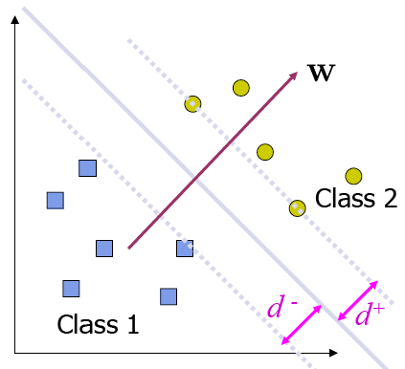

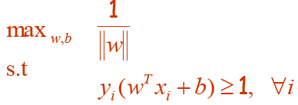
Support vector machine
Consider the margin
The optimization problem
Convex quadratic programming with linear constrains.

Slide 16


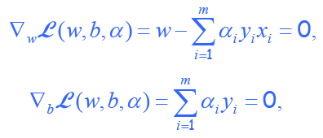

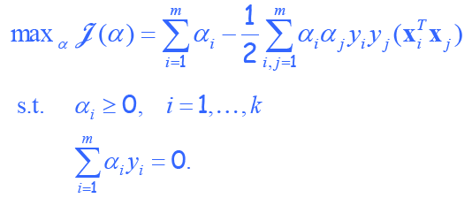
Lagrangian
Lagrangian duality
We have
Optimize:
Still a quadratic programming problem

Slide 17

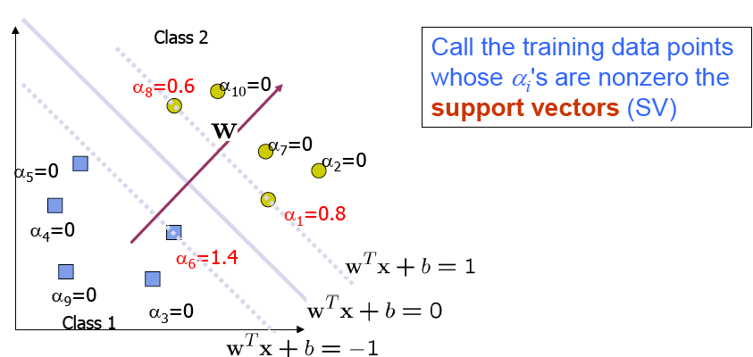
Can be recovered:

Slide 18
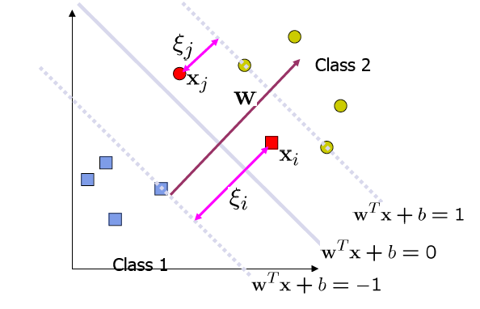
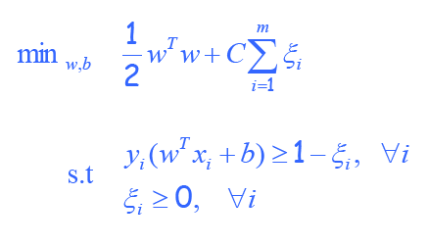
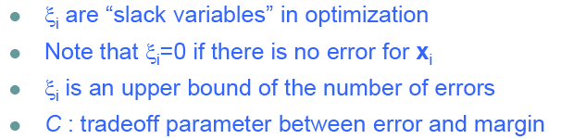
How can we do if it is a nonlinearly separable problem

Slide 19
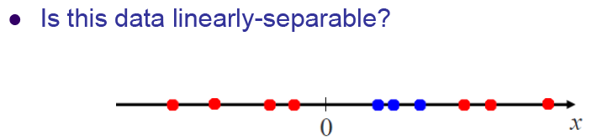
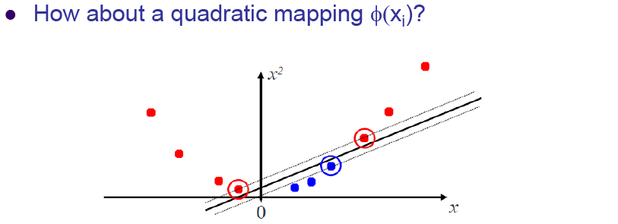
The Kernel Trick

Slide 20
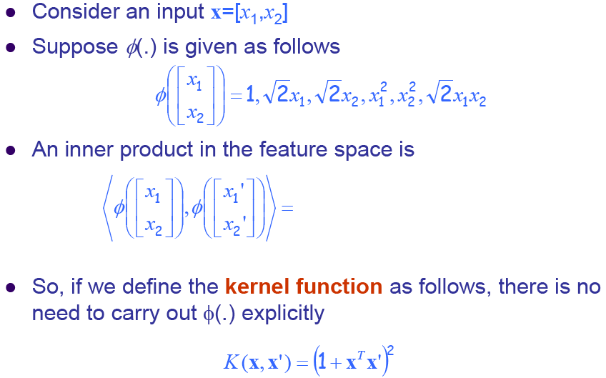
Some example for feature mapping and kernel…

Slide 21
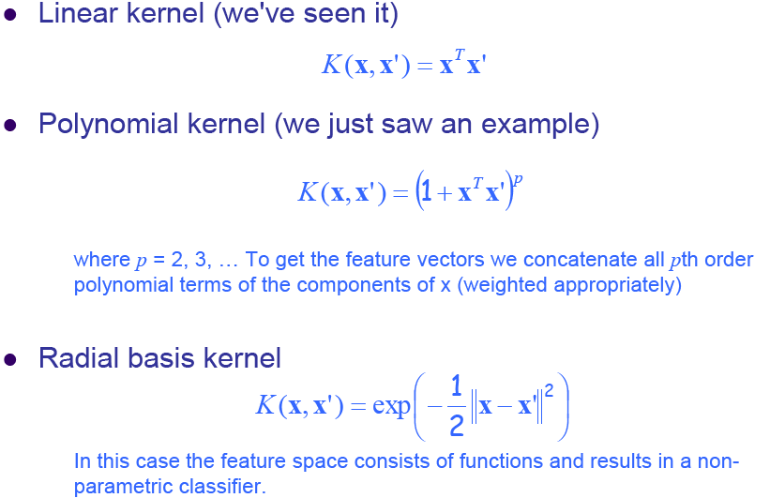

Slide 22
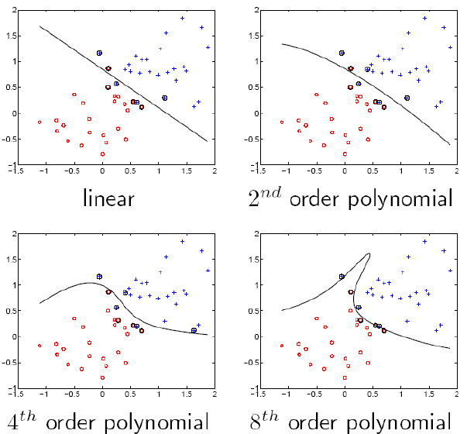
Example of SVM using kernel function

Slide 23


Logistic Regression
Optimal classifier (ML):
Naïve Bayes classifier:
How not learn P(Y|X) directly? Or learn the boundary directly?
Logistic Regression
Linear regression + Logistic (Decision) function

Slide 24
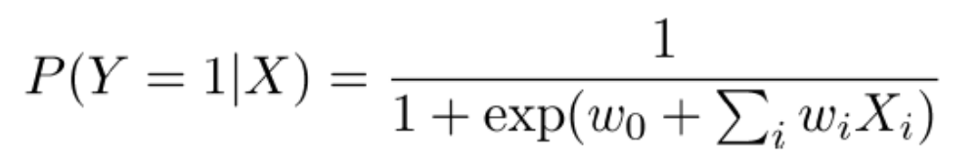
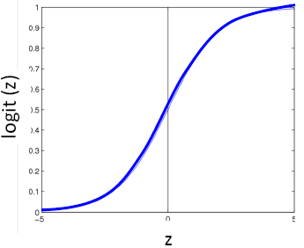
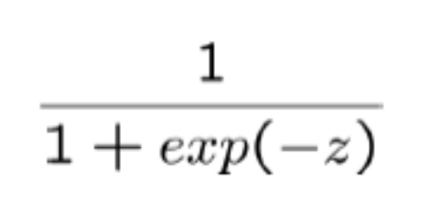
Assume:
Logistic function:

Slide 25
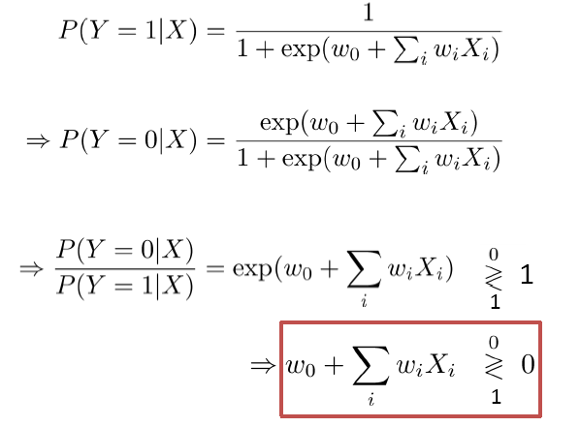
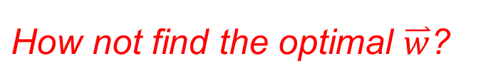

Slide 26

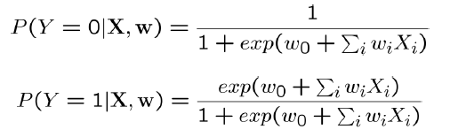
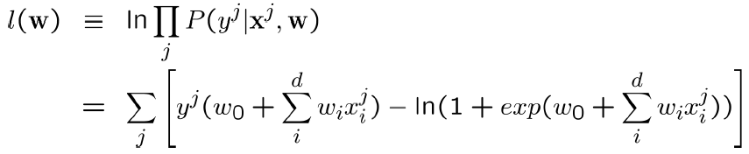
For training data, maximum conditional likelihood estimates?
Concave function ➔
Gradient Ascent (concave) / Gradient Descent (convex)

Slide 27
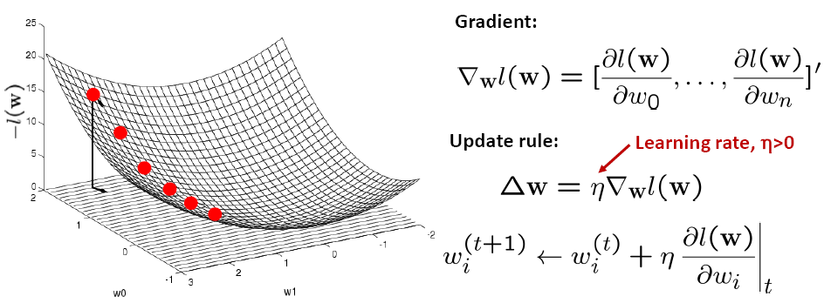


Slide 28
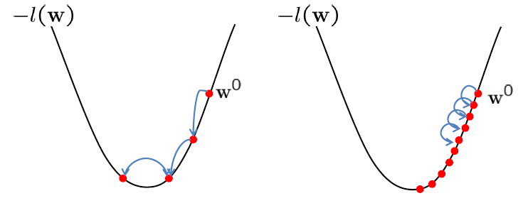
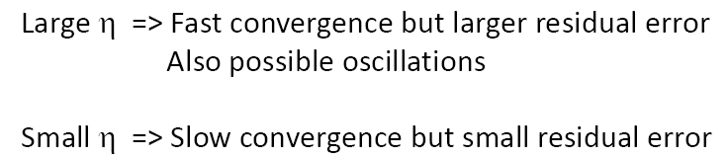

Slide 29
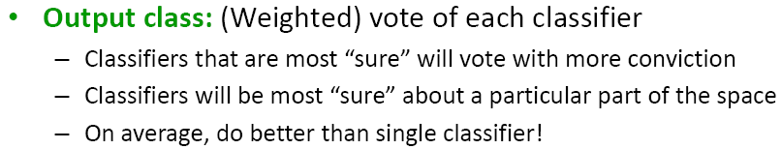
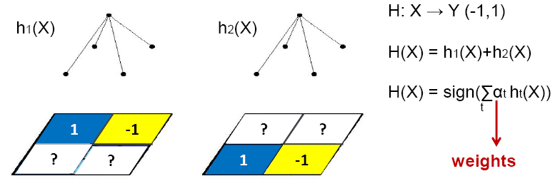
Boosting

Slide 30
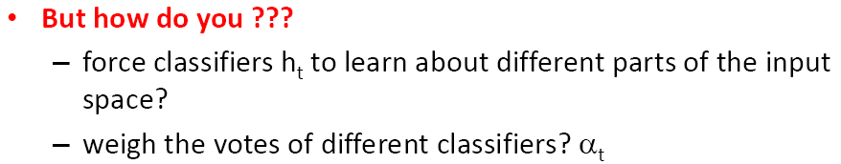
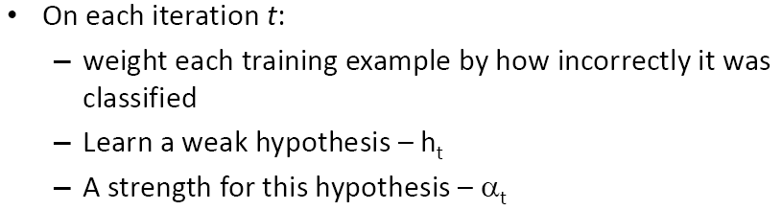

Adaptive Boosting (AdaBoost)

Slide 31
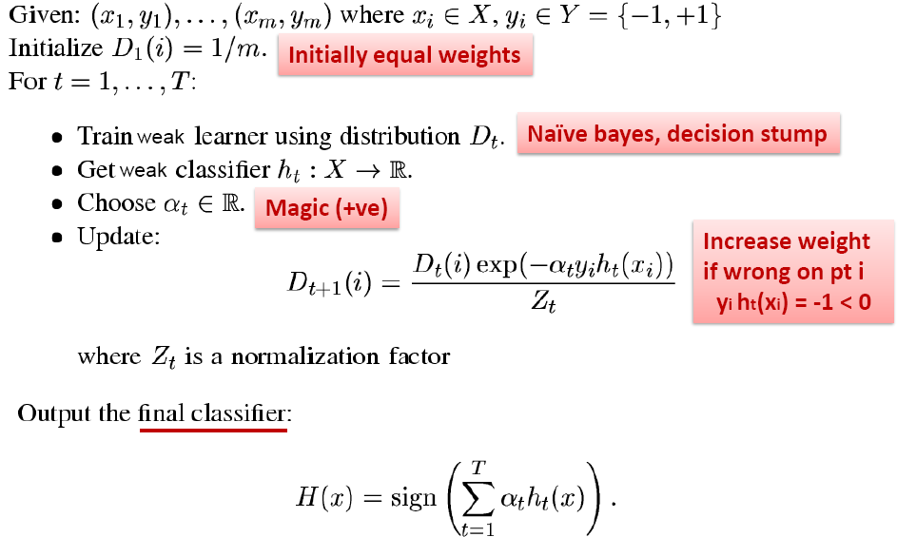

AdaBoost Process:

Slide 32
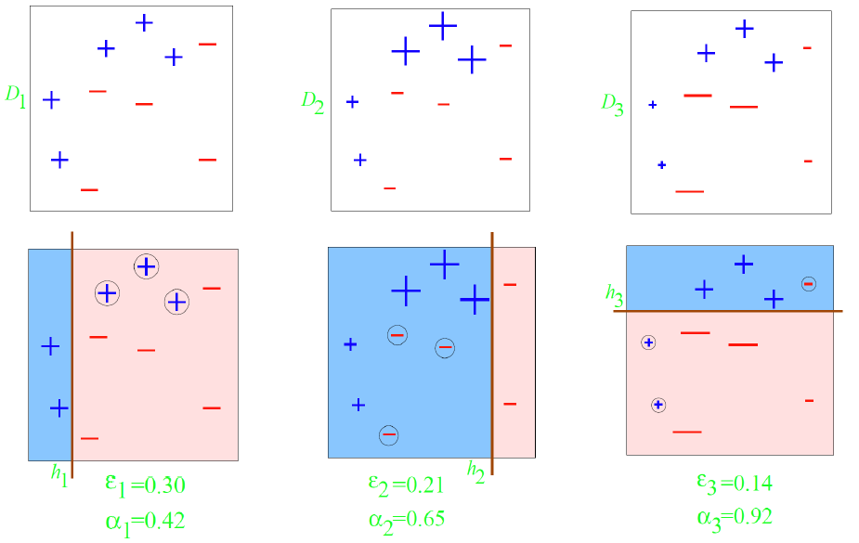

Slide 33
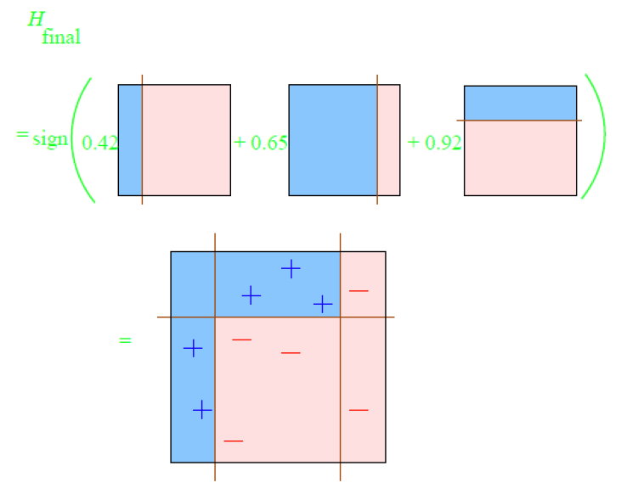

Slide 34
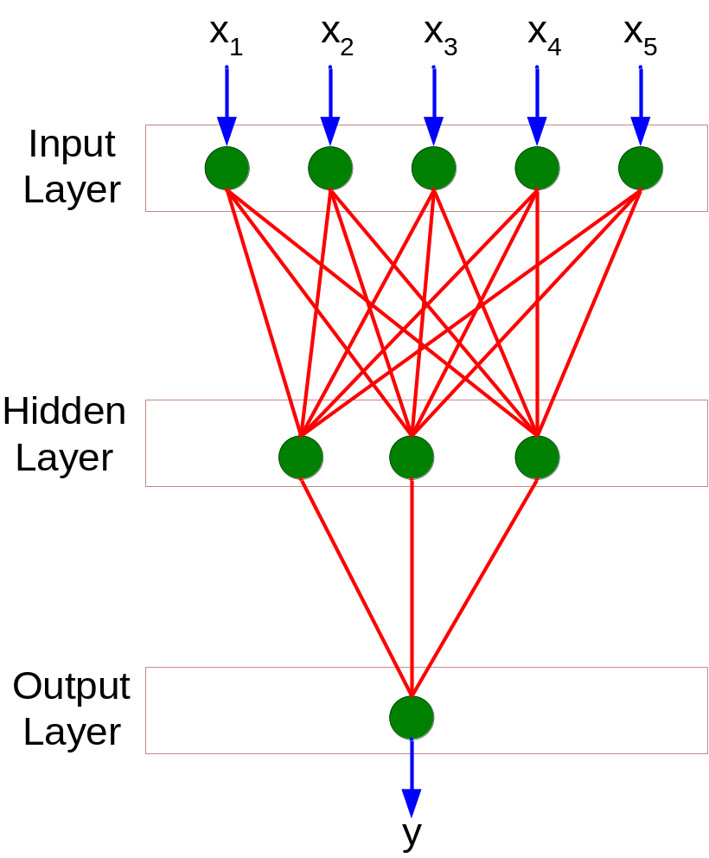
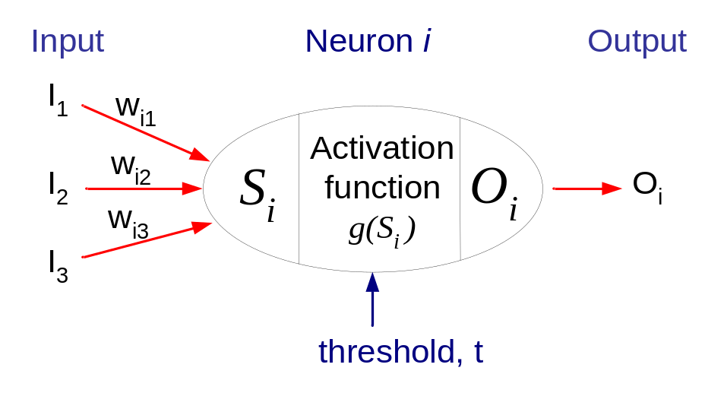
ANN
Training ANN means learning the weights of the neurons
Deep Learning!!
Each layer is the logistic regression
Easy to overfit, difficult to tune the parameters.
NOT outperform other classifier (SVM+Boosting)

Slide 35
Clustering
Finding groups of objects such that the objects in a group will be similar (or related) to one another and different from (or unrelated to) the objects in other groups
Classical unsupervised learning,
The process of dividing the data set into clusters according to the similarity between the data
Discovering groups and identifying interesting distributions in the underlying data
Inter-cluster distances are maximized
Intra-cluster distances are minimized

Slide 36
Notion of a Cluster can be Ambiguous
How many clusters?
Six Clusters
Two Clusters
Four Clusters

Slide 37
Algorithms:
K-means and its variants
Hierarchical clustering
Density based clustering DBSCAN (Density-based spatial clustering of applications with noise)

Slide 38
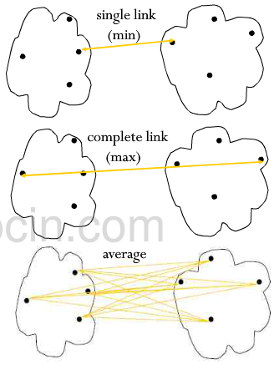
How to measure the similarity ➔ Distance
Point Distance
Cluster Distance
Euclidean distance
Jaccard distance
Cosine distance
Edit distance, for string similarity
Hamming distance
…

Slide 39

Algorithm of K-Means
Randomly select k data from the set as the initial mean vector of clusters
Other data are partitioned into the closet cluster measured by its distance to corresponding mean vector
Update the mean vector of new generated clusters
Repeat step 2-3, until clustering is stable
Most of the convergence happens in the first few iterations
--Often stopping condition is changed to ‘Until few points change clusters’
Need to preset the number of cluster
Sensitive to noise and initial means
  Complexity is O( n * K * I * d )
  n = number of points, K = number of clusters,
  I = number of iterations, d = number of attributes

Slide 40






Importance of Choosing Initial Centroids

Slide 41
The importance of choosing initial centroids

Slide 42
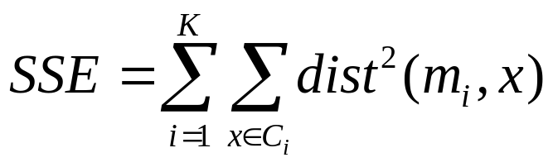
Evaluating K-means Clusters
Most common measure is Sum of Squared Error (SSE)
  For each point, the error is the distance to the nearest cluster
  To get SSE, we square these errors and sum them.
  x is a data point in cluster C_{i} and m_{i} is the representative point for cluster C_{i}
    can show that m_{i} corresponds to the center (mean) of the cluster
  Given two clusters, we can choose the one with the smallest error
  One easy way to reduce SSE is to increase K, the number of clusters
    A good clustering with smaller K can have a lower SSE than a poor clustering with higher K

Slide 43
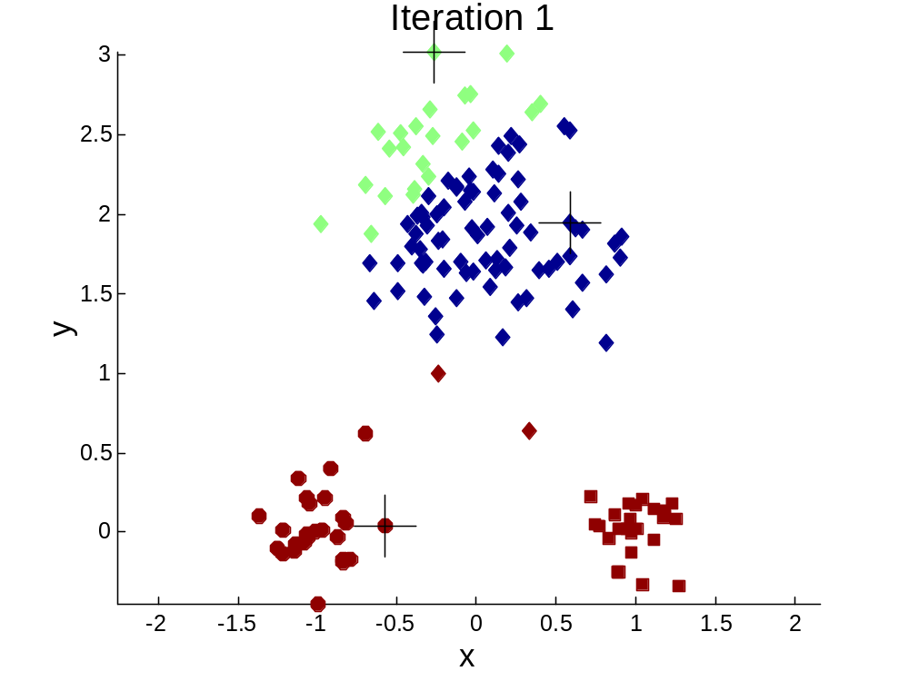


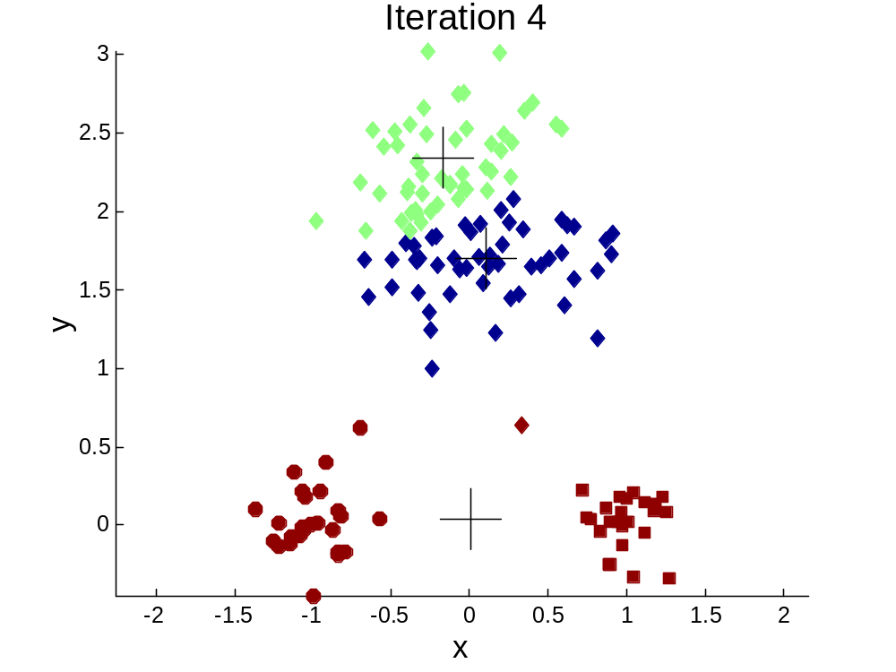
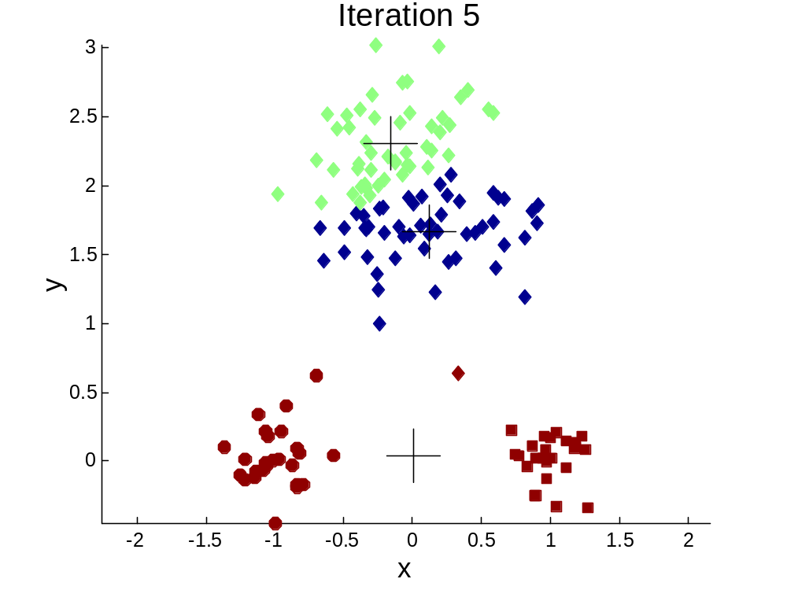
Importance of Choosing Initial Centroids …

Slide 44
Importance of Choosing Initial Centroids …

Slide 45
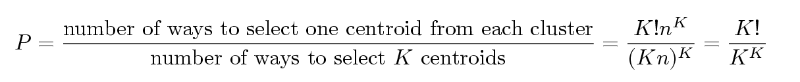
Problems with Selecting Initial Points
If there are K ‘real’ clusters then the chance of selecting one centroid from each cluster is small.
  Chance is relatively small when K is large
  If clusters are the same size, n, then
  For example, if K = 10, then probability = 10!/10¹⁰ = 0.00036
  Sometimes the initial centroids will readjust themselves in ‘right’ way, and sometimes they don’t

Slide 46
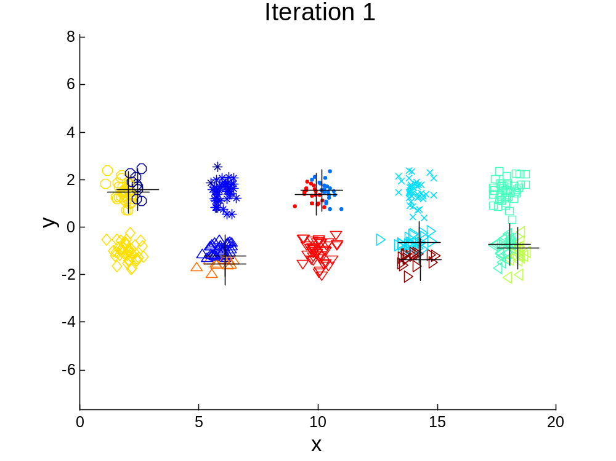
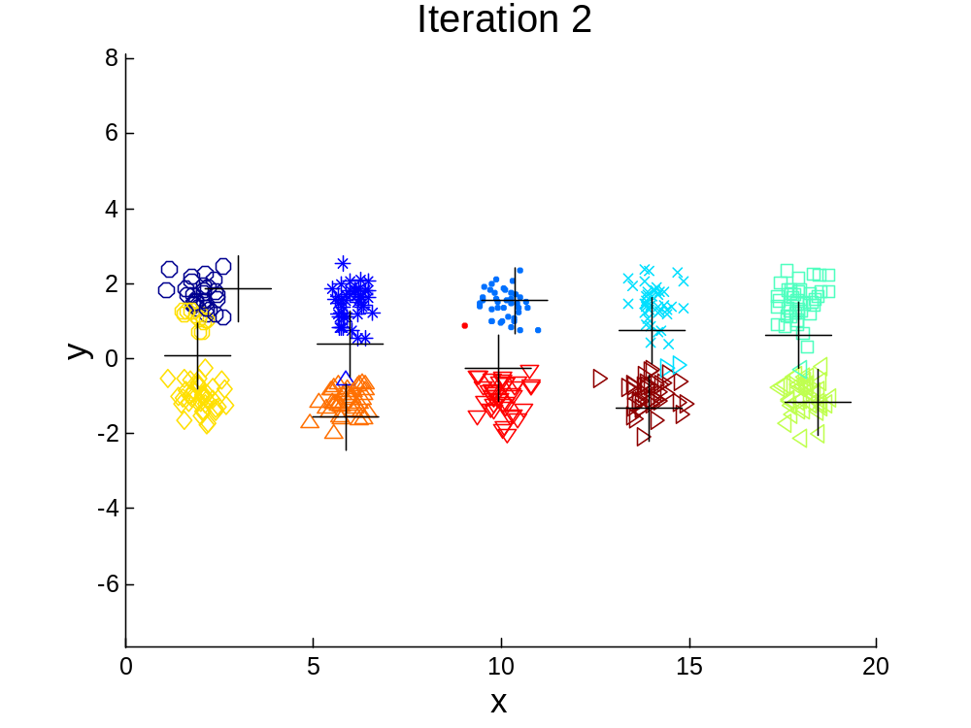


Starting with two initial centroids in one cluster of each pair of clusters

Slide 47
Starting with two initial centroids in one cluster of each pair of clusters

Slide 48




Starting with some pairs of clusters having three initial centroids, while other have only one.

Slide 49
Starting with some pairs of clusters having three initial centroids, while other have only one.

Slide 50
Solutions to Initial Centroids Problem
Multiple runs
  Helps, but probability is not on your side
Sample and use hierarchical clustering to determine initial centroids
Select more than k initial centroids and then select among these initial centroids
  Select most widely separate
  Postprocessing
Bisecting K-means
  Not as susceptible to initialization issues

Slide 51
Pre-processing
  Normalize the data
  Eliminate outliers
Post-processing
  Eliminate small clusters that may represent outliers
  Split ‘loose’ clusters, i.e., clusters with relatively high SSE
  Merge clusters that are ‘close’ and that have relatively low SSE
  Can use these steps during the clustering process

Slide 52

Bisecting K-means algorithm
-- Variant of K-means that can produce a partition or a hierarchical clustering

Slide 53











Slide 54
Limitation of K-means:
K-means has problems when clusters are of differing
  Sizes
  Densities
  Non-globular shapes
K-means has problems when the data contains outliers.

Slide 55


Limitations of K-means: Differing Sizes
Original Points
K-means (3 Clusters)

Slide 56


Limitations of K-means: Differing Density
Original Points
K-means (3 Clusters)

Slide 57


Limitations of K-means: Non-globular Shapes
Original Points
K-means (2 Clusters)

Slide 58

Overcoming K-means Limitations
Original Points K-means Clusters
One solution is to use many clusters. Find parts of clusters, but need to put together.

Slide 59



Algorithm of Hierarchical clustering (Agglomerative)
Select each object as cluster (if we have N object, we will have clusters at the beginning)
Merge two closest cluster based on cluster distance
Repeat step 2, until number of cluster is on or known # of clusters
Produces a set of nested clusters organized as a hierarchical tree
Can be visualized as a dendrogram
  A tree like diagram that records the sequences of merges or splits

Slide 60
DBSCAN
DBSCAN is a density-based algorithm.
  Density = number of points within a specified radius (Eps)
  A point is a core point if it has more than a specified number of points (MinPts) within Eps
    These are points that are at the interior of a cluster
  A border point has fewer than MinPts within Eps, but is in the neighborhood of a core point
  A noise point is any point that is not a core point or a border point.

Slide 61


Slide 62

DBSCAN Algorithm
Eliminate noise points
Perform clustering on the remaining points

Slide 63


DBSCAN: Core, Border and Noise Points
Original Points
Point types: core, border and noise
Eps = 10, MinPts = 4

Slide 64

When DBSCAN Works Well:
Original Points
Clusters
Resistant to Noise
Can handle clusters of different shapes and sizes

Slide 65



When DBSCAN Does NOT Work Well:
(MinPts=4, Eps=9.75).
Original Points
Varying densities
High-dimensional data
(MinPts=4, Eps=9.92)

Slide 66
Clustering Algorithms in Mahout (MapRedece):
Canopy Clustering | Canopy聚类
K-means Clustering | K均值算法
Fuzzy K-means | 模糊K均值
Expectation Maximization | EM聚类（期望最大化聚类）
Mean Shift Clustering | 均值漂移聚类
Hierarchical Clustering | 层次聚类
Dirichlet Process Clustering | 狄里克雷过程聚类
Latent Dirichlet Allocation | LDA聚类
Spectral Clustering | 谱聚类

Slide 67

Association analysis
Given a set of transactions, find rules that will predict the occurrence of an item based on the occurrences of other items in the transaction
Market-Basket transactions
Example of Association Rules
{Diaper} → {Beer},
{Milk, Bread} → {Eggs,Coke},
{Beer, Bread} → {Milk},

Slide 68

Definition: Frequent Itemset
Itemset
  A collection of one or more items
    Example: {Milk, Bread, Diaper}
  k-itemset
    An itemset that contains k items
Support count (σ)
  Frequency of occurrence of an itemset
  E.g. σ({Milk, Bread,Diaper}) = 2
Support
  Fraction of transactions that contain an itemset
  E.g. s({Milk, Bread, Diaper}) = 2/5
Frequent Itemset
  An itemset whose support is greater than or equal to a minsup threshold

Slide 69



Definition: Association Rule
Association Rule
  An implication expression of the form X → Y, where X and Y are itemsets
  Example:
  {Milk, Diaper} → {Beer}
Rule Evaluation Metrics
  Support (s)
    Fraction of transactions that contain both X and Y
  Confidence (c)
    Measures how often items in Y
    appear in transactions that
    contain X
Example:

Slide 70
Association Rule Mining Task
Given a set of transactions T, the goal of association rule mining is to find all rules having
  support ≥ minsup threshold
  confidence ≥ minconf threshold
Brute-force approach:
  List all possible association rules
  Compute the support and confidence for each rule
  Prune rules that fail the minsup and minconf thresholds
  ⇒ Computationally prohibitive!

Slide 71
Mining Association Rules
Example of Rules:
{Milk,Diaper} → {Beer} (s=0.4, c=0.67)
{Milk,Beer} → {Diaper} (s=0.4, c=1.0)
{Diaper,Beer} → {Milk} (s=0.4, c=0.67)
{Beer} → {Milk,Diaper} (s=0.4, c=0.67)
{Diaper} → {Milk,Beer} (s=0.4, c=0.5)
{Milk} → {Diaper,Beer} (s=0.4, c=0.5)
Observations:
All the above rules are binary partitions of the same itemset:
{Milk, Diaper, Beer}
Rules originating from the same itemset have identical support but
can have different confidence
Thus, we may decouple the support and confidence requirements

Slide 72
Mining Association Rules
Two-step approach:
  Frequent Itemset Generation
    Generate all itemsets whose support ≥ minsup
  Rule Generation
    Generate high confidence rules from each frequent itemset, where each rule is a binary partitioning of a frequent itemset
Frequent itemset generation is still computationally expensive
Given d items, there are 2^{d} possible candidate itemsets!!!

Slide 73
Frequent Itemset Generation Strategies
Reduce the number of candidates (M)
  Complete search: M=2^{d}
  Use pruning techniques to reduce M
Reduce the number of comparisons (NM)
  Use efficient data structures to store the candidates or transactions
  No need to match every candidate against every transaction

Slide 74


Apriori Algorithm
  If an itemset is frequent, then all of its subsets must also be frequent
Found to be Infrequent
Pruned supersets

Slide 75



Items (1-itemsets)
Pairs (2-itemsets)
(No need to generate
candidates involving Coke
or Eggs)
Minimum Support = 3
Triplets (3-itemsets)
If every subset is considered,
⁶C₁ + ⁶C₂ + ⁶C₃ = 41
With support-based pruning,
6 + 6 + 1 = 13

Slide 76
Apriori Algorithm Process
  Let k=1
  Generate frequent itemsets of length 1
  Repeat until no new frequent itemsets are identified
    Generate length (k+1) candidate itemsets from length k frequent itemsets
    Prune candidate itemsets containing subsets of length k that are infrequent
    Count the support of each candidate by scanning the DB
    Eliminate candidates that are infrequent, leaving only those that are frequent

Slide 77

Candidate counting:
  Scan the database of transactions to determine the support of each candidate itemset
  To reduce the number of comparisons, store the candidates in a hash structure
    Instead of matching each transaction against every candidate, match it against candidates contained in the hashed buckets

Slide 78
Example:
Suppose you have 15 candidate itemsets of length 3:
{1 4 5}, {1 2 4}, {4 5 7}, {1 2 5}, {4 5 8}, {1 5 9}, {1 3 6}, {2 3 4}, {5 6 7}, {3 4 5}, {3 5 6}, {3 5 7}, {6 8 9}, {3 6 7}, {3 6 8}
Hash function
Max leaf size: max number of itemsets stored in a leaf node (if number of candidate itemsets exceeds max leaf size, split the node)
Hash function
2 3 4
5 6 7
3,6,9
1,4,7
1 4 5
3 4 5
3 5 6
3 5 7
6 8 9
3 6 7
3 6 8
1 3 6
2,5,8
1 2 4
4 5 7
1 2 5
4 5 8
1 5 9

Slide 79
Hash Function
Candidate Hash Tree
1,4,7
3,6,9
2,5,8
2 3 4
5 6 7
1 4 5
1 3 6
3 4 5
3 5 6
3 6 7
Hash on 1, 4 or 7
3 5 7
3 6 8
1 2 4
1 5 9
6 8 9
1 2 5
4 5 7
4 5 8

Slide 80

Given a transaction t, what are the possible subsets of size 3?

Slide 81
1 2 3 5 6
transaction
Hash Function
1 +
2 3 5 6
2 +
3 5 6
1,4,7
3,6,9
1 2 +
3 5 6
3 +
5 6
2,5,8
1 3 +
5 6
2 3 4
1 5 +
6
5 6 7
1 4 5
1 3 6
3 4 5
3 5 6
3 6 7
3 5 7
3 6 8
1 2 4
1 2 5
1 5 9
6 8 9
4 5 7
4 5 8
Match transaction against 11 out of 15 candidates

Slide 82
FP-growth Algorithm
Use a compressed representation of the database using an FP-tree
Once an FP-tree has been constructed, it uses a recursive divide-and-conquer approach to mine the frequent itemsets

Slide 83

FP-tree construction
null
After reading TID=1:
A:1
B:1
After reading TID=2:
null
A:1
B:1
B:1
C:1
D:1

Slide 84


FP-Tree Construction
Transaction Database
null
A:8
B:2
B:5
C:2
C:1
D:1
Header table
D:1
C:3
E:1
D:1
E:1
D:1
E:1
D:1
Pointers are used to assist frequent itemset generation

Slide 85
Prefix Path
null
A:8
B:2
C:2
C:1
D:1
E:1
D:1
E:1
E:1
Path for node E

Slide 86
null
A:8
B:2
B:5
C:2
C:1
D:1
D:1
C:3
D:1
D:1
D:1
Path for node D

Slide 87
null
A:8
B:2
B:5
C:2
C:1
null
C:3
Path for node C
null
A:8
Path for node A
A:8
B:2
B:5
Path for node B

Slide 88
FP-Growth (prefix path for node E)
null
null
A:8
B:2
A:8
C:2
C:1
D:1
C:1
C:2
D:1
E:1
D:1
E:1
E:1
D:1
Prefix Path for E
Conditional FP-tree for node E

Slide 89
null
A:2
null
C:1
D:1
A:8
D:1
Conditional FP-tree for DE
Prefix Path for DE

Slide 90
null
null
A:2
C:1
A:8
C:1
Prefix Path for DE
Conditional FP-tree for CE

Slide 91
Demo: Mahout FP-Growth
hadoop jar mahout-examples-0.9-job.jar org.apache.mahout.fpm.pfpgrowth.FPGrowthDriver -i retail.dat -o patterns -k 10 -method mapreduce -regex '[\ ]' -s 20
mahout seqdumper -i patterns/frequentpatterns/part-r-00000

Slide 92
Rule Generation
Given a frequent itemset L, find all non-empty subsets f ⊂ L such that f → L – f satisfies the minimum confidence requirement
  If {A,B,C,D} is a frequent itemset, candidate rules:
    ABC →D, ABD →C, ACD →B, BCD →A,
    A →BCD, B →ACD, C →ABD, D →ABC
    AB →CD, AC → BD, AD → BC, BC →AD,
    BD →AC, CD →AB,
If |L| = k, then there are 2^{k} – 2 candidate association rules (ignoring L → ∅ and ∅ → L)

Slide 93
How to efficiently generate rules from frequent itemsets?
  In general, confidence does not have an anti-monotone property
    c(ABC →D) can be larger or smaller than c(AB →D)
  But confidence of rules generated from the same itemset has an anti-monotone property
  e.g., L = {A,B,C,D}:
  c(ABC → D) ≥ c(AB → CD) ≥ c(A → BCD)

Slide 94


Lattice of rules
Low Confidence Rule
Pruned Rules

Slide 95

Rule Generation for Apriori Algorithm
Candidate rule is generated by merging two rules that share the same prefix
in the rule consequent
join(CD=>AB,BD=>AC)
would produce the candidate
rule D => ABC
Prune rule D=>ABC if its
subset AD=>BC does not have
high confidence

